Slide 1


Sprocket Central Pty Ltd
Data Insights and Visualization
[Kamakshi]

Slide 2
Agenda
What are the trends in the underlying data.
Which customer segment has highest customer value.
Dashboard

Slide 3
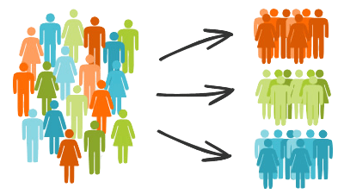
Note: The data and information in this document is reflective of a hypothetical situation and client. This document is to be used for KPMG Virtual Internship purposes only.
Introduction
We are here to Visualize Big Data and to determine customer behaviour and trend.
To analyse customer behaviour and trend, we are using 3 dataset provided by Sprocket Central company that specializes in high-quality bikes and cycling accessories.
Customer Segmentation

Slide 4
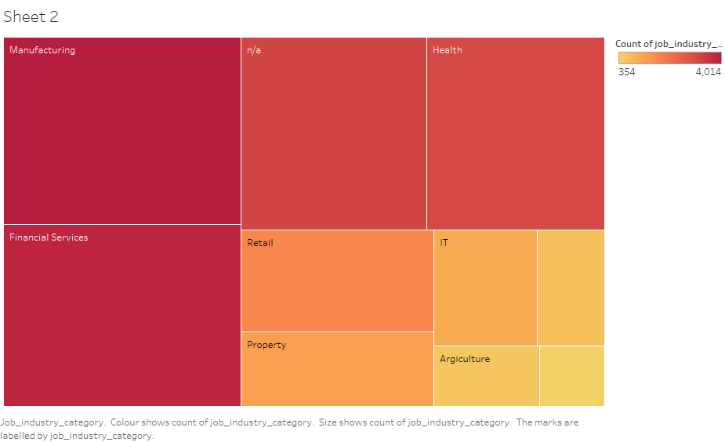
Data Exploration
Job Industry Distribution
Most of the customers are from Manufacturing and financial services.
Small number of customer are in Agriculture, Telecommunication and Entertainment.

Slide 5
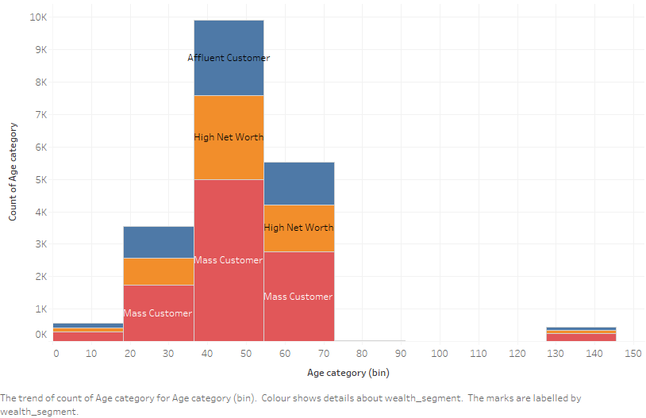
Data Exploration
Age Category with Wealth Segment
In all age categories, number of Mass customers is high, so we should focus on this class.
The second highest class is High Net worth.
But Affluent customer can outperforms the High Net worth customer in 50-59 age group.

Slide 6
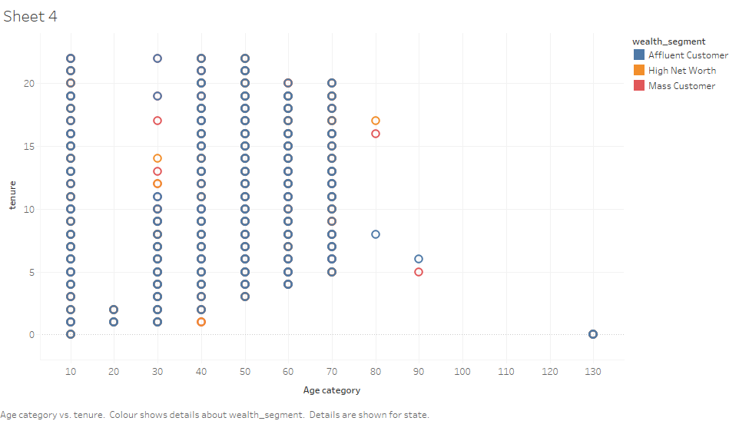
Data Exploration
Age Category with Tenure
There is Outlier in the customer list at 130 age group, which we have to remove.
High tenure under 30-59 age group and at small age group around 10.
In small age group all cutomer are Affluent .

Slide 7
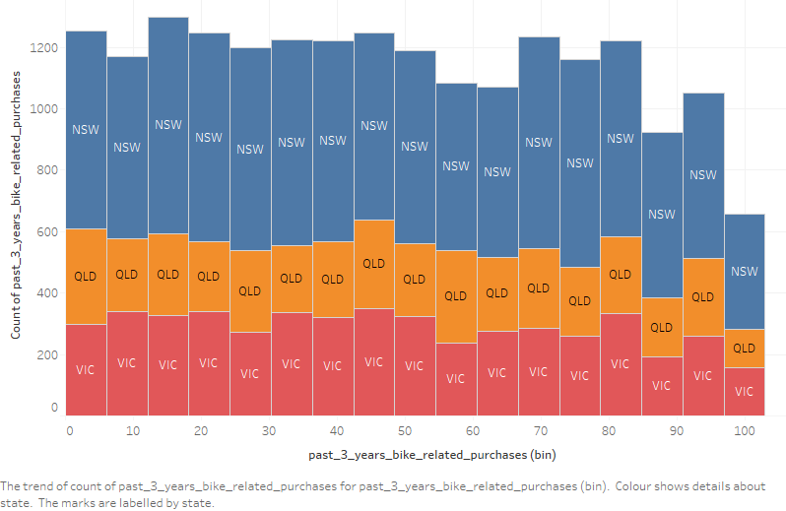
Data Exploration
Bike related purchases with States
Most of the past 3 years bike related purchases are from NSW State.
Very less amount of sales in QLD.

Slide 8
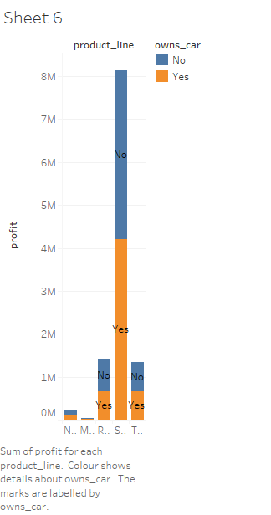
Data Exploration
Profit with Product line and car owns
As we can see high amount of profit is generated from Standard product line.
Road and touring are same.
Very less amount of profit is generated in Mountain product line.

Slide 9
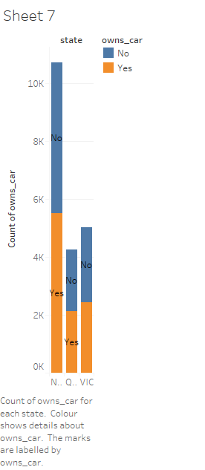
Data Exploration
State distribution with who owns car or not
NSW has the largest amount of people that do not own a car. Also NSW is high populated.
Victoria is quite even.
QLD has relatively high number of customers that own a car.

Slide 10
Data Exploration
This scatter plot shows the correlation between Recency and Frequency.
Very low frequency of 0-2 correlated with high recency values.
Customers that have visited more recently(0-50) have a higher chance of visiting more frequently.

Slide 11
Data Exploration
This scatter plot shows the correlation between Frequency and Monetary.
There is a positive relationship between frequency and monetary as with the increase of frequency, revenue is also increasing.
High revenue customers are between 8 to 12 frequency.

Slide 12
Data Exploration
Profit with Recency of the customers
This scatter plot shows the correlation between Recency and Monetary.
It is representing customers who purchased more recently have generate more revenue, than customer who visited a while ago.

Slide 13
Data Exploration
Brands with Sum of Selling Price
High amount of sales is generated from Brands Trek Bicycles and Solex.
There is comparatively less amount of sales in Norco Bicycles.

Slide 14
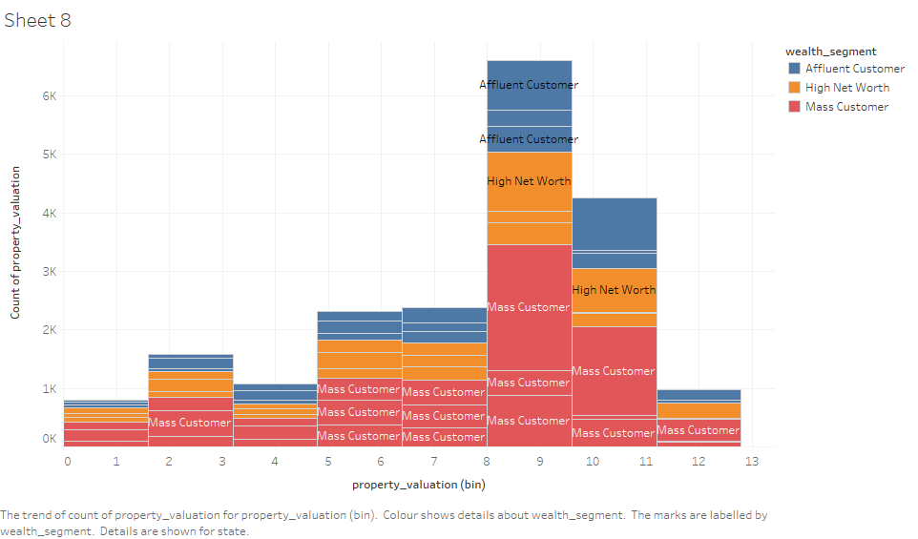
Data Exploration
Property valuation with wealth segment

Slide 15
Which Customer segment has the highest customer value

Slide 16
Which Customer segment has the highest customer values

Slide 17
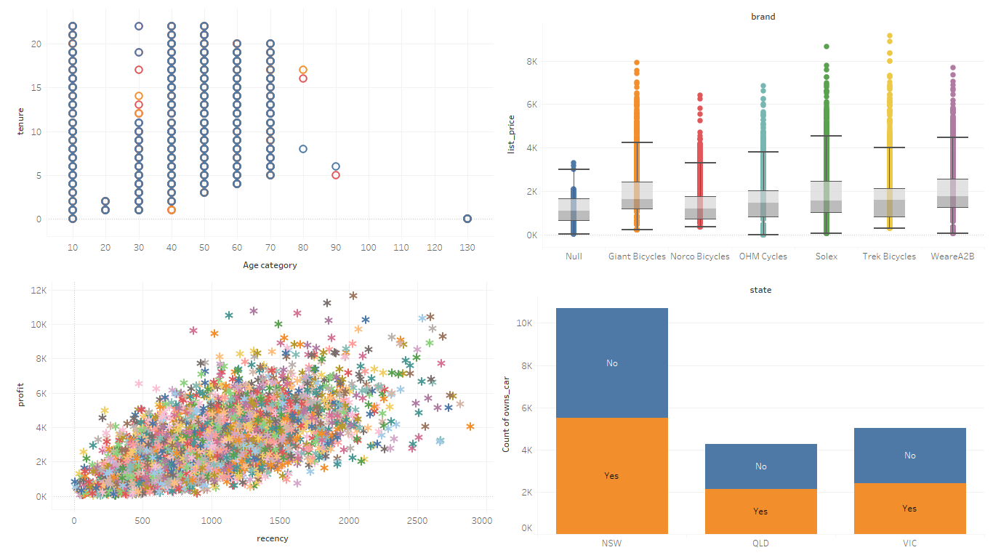
Dashboard

Slide 18
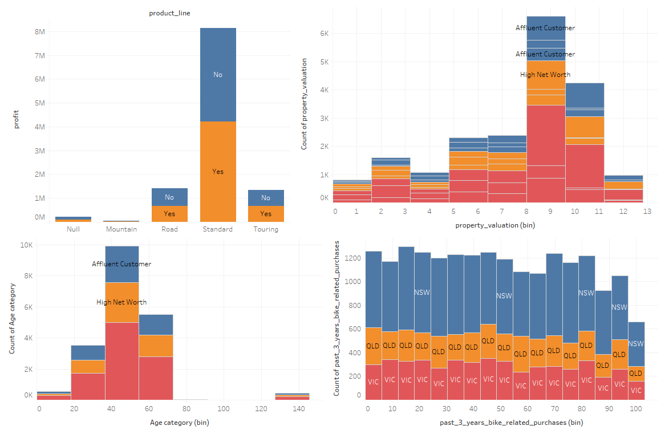
Dashboard

Slide 19
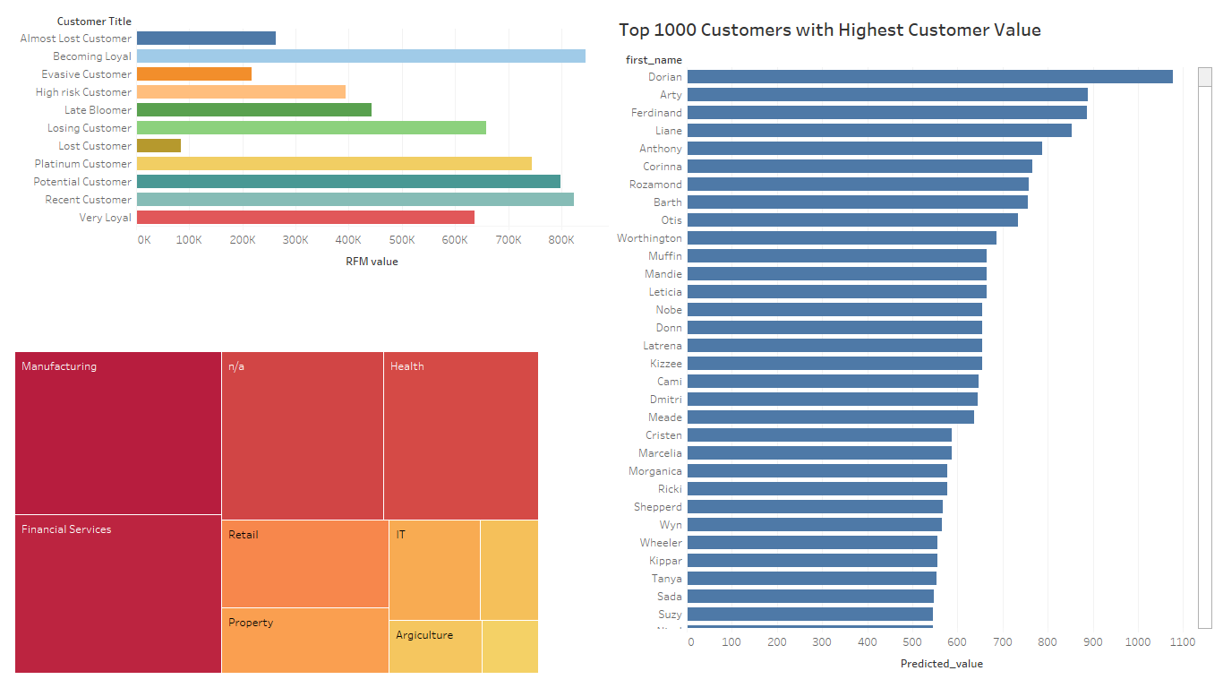
Dashboard

